Slide 1
xxHFLx014 Basic Setup and Clone Westan Australia
Updated: 04/07/19 CB Location: Dropbox\Knowledge Base\Training Filename: xxHFLx014 Basic Setup and Clone

Slide 2
Goals & Assumptions
Goals
Show how to update the SW and configure the 1st TV with Free to Air TV channels via Coax
Show how to copy the config from the 1st TV and simplify the SW update and configuration of other TVs
Show the customisation required for each TV
Assumption:
TVs are xxHFLx014, xxHFLx114, xxHFLx214 platform
The TV hasn’t been configured, fresh out of the box
It is not an IPTV Installation

Slide 3
Training Overview
TV: Receiving and Unboxing TVs
Preparation: Download the latest SW version
1st TV: Set Up, Update SW, Initiation, Configure
1st TV: Clone Out (copying configuration to a USB)
Other TVs: Set Up, Update SW & Clone In, Customisation
Other tasks

Slide 4
TV: Receiving and Unboxing TVs
Receiving:
Please sign the delivery docket “Subject to inspection”
If there’s damage to the box upon delivery, clearly indicate the damage in the delivery docket and take the photo of the issue.
Unboxing:
When taking the TV out of the box, DO NOT put any pressure on the TV’s panel (the main screen that displays content), as it will cause damage to the TV.
DOA (including damage) Consideration (see next page)

Slide 5
DOA considerations
Take photos of error/issue and serial number
Take photos of unit and packaging (all sides). ie. Entire TV (from front, rear, LHS, RHS), Entire box (from front, rear, LHS, RHS), Serial Number on TV, Serial Number on Box.
Repack in original packaging. We cannot honour a damage claim if the original packaging is not present. Always fill in an online warranty form
support.westan.com.au

Slide 6
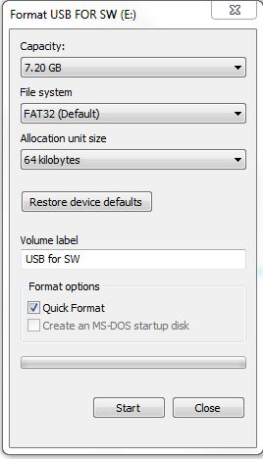
Preparation: Download the Latest SW Version
Prepare the USB Drive
Format USB Drive using following parameters:
File system = FAT32
Allocation unit size = 64 kilobyte
Copy the files (especially autorun.upg) from the link into the root directory of the empty USB Drive
Ensure the autorun.upg filename is all lowercase.
You will need:
Latest software version for your model of TV:
xxHFLx014:
Westan support KB article
Empty USB drives

Slide 7
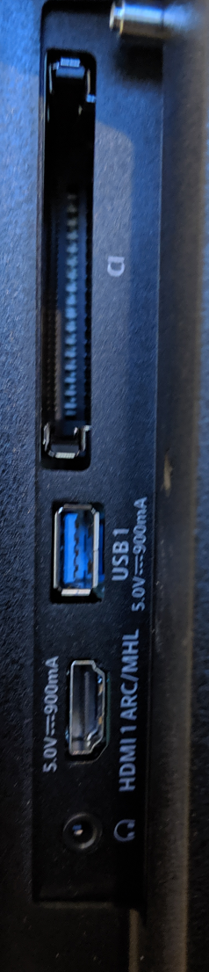
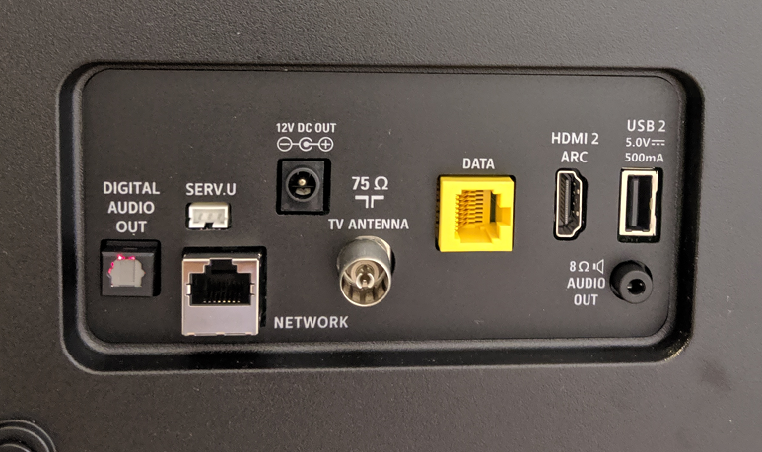
1st TV – Set up
Connect Network, Antenna and Power
Take note of USB 1 Location
Yellow RJ45 Interface is not Ethernet port.. It is Serial port
NOT FOR NETWORK CONNECTION
NETWORK
ANTENNA
USB 1

Slide 8
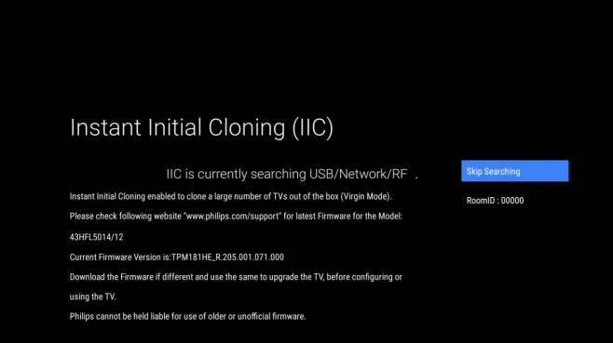
1st TV – Turn On The TV
Turn On the TV
When you turn on the TV for the first time, you’ll be presented with the Instant Initial Cloning (IIC) Page
Next: Update SW

Slide 9
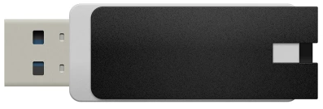
1st TV – Update SW
Plug the USB Drive with the latest SW version into the USB1 Port (rear bottom of TV) – see picture
Next – TV automatically detects the SW on the USB

Slide 10
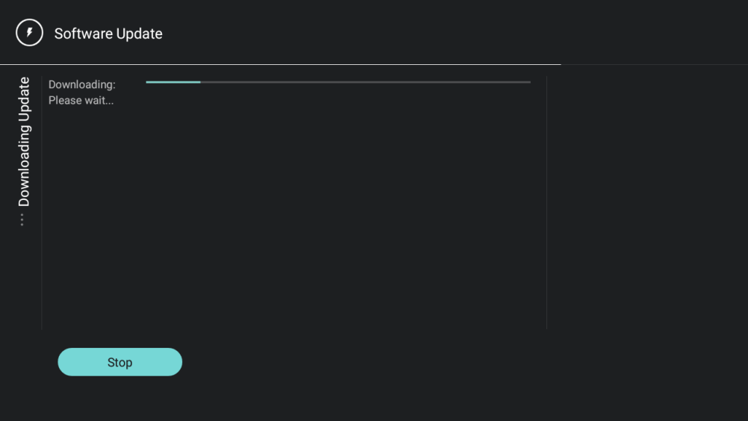
1st TV – Update SW
TV will automatically detect the USB Drive containing the SW update, download the file to the TV’s memory and begin SW installation
If this doesn’t happen:
Try different USB Drive model
Confirm USB is formatted and prepared with correct SW version.
Check if the autorun.upg is incorrectly named or has incorrect case (e.g. Autorun.upg - capital 1st letter)
Check if the TV is not already running the latest SW version.

Slide 11
1st TV – Verify SW version
When the update is complete, the TV will show the Instant Initial Cloning (IIC) Page
The new TV SW Version is shown
For this 1st TV, select OK to “Skip” this page

Slide 12
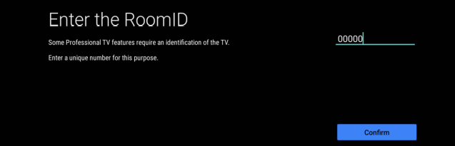
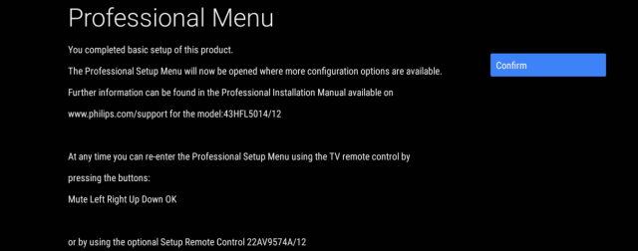
1st TV – Virgin Installation settings
Enter Room ID = 00000 – 99999
(set correctly)
Virgin installation is complete
Click Confirm to go to next screen

Slide 13
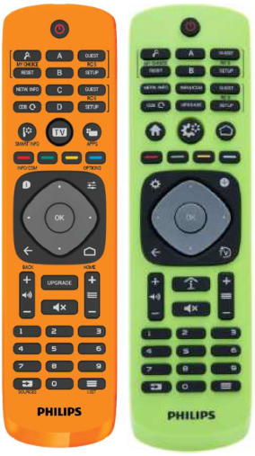
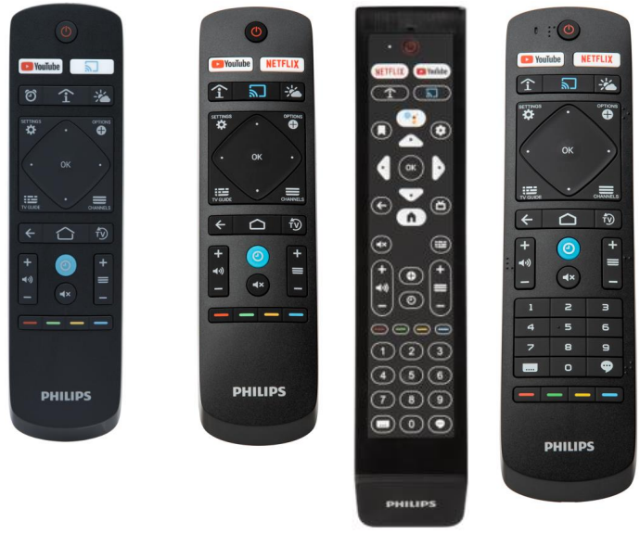
Accessing Professional Settings Menu
 | Master Remote Control | Guest Remote Control
Professional Settings Menu | RC 6 Setup, Home/Menu | MUTE, LEFT, RIGHT, UP, DOWN, OK Within 2 seconds
CSM Menu |  | 1,2,3,6,5,4

Slide 14
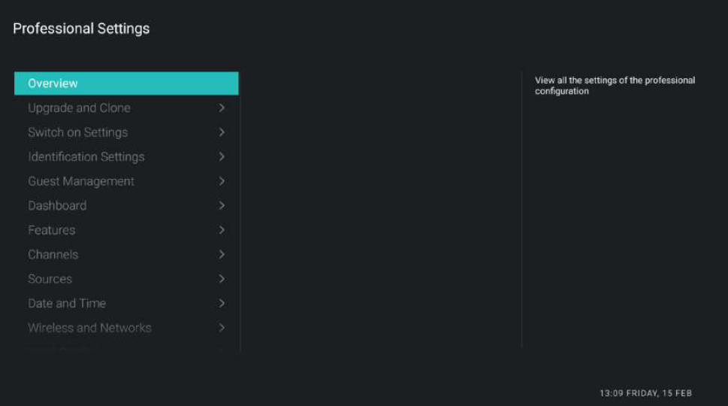
Going Into Professional Settings Menu
As long as you are in the Professional menu, a message notification will be shown at the bottom of the screen and you know that any changes made will be saved to the clone.
If you do not see this message, it means you are in Guest Mode and all changes will be reset/cleared/deleted after TV is put in standby/rebooted.

Slide 15
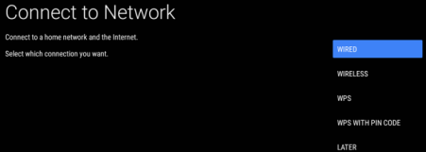
1st TV - Configure – Network
Navigate to [Wireless and Networks] -> [Connect to Network] menu.
Choose [Wired] of [Wireless] from selection
The router is contentiously scanned until a network is found.
Screen confirms that the wired network is connected

Slide 16
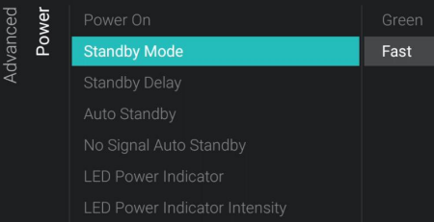
1st TV - Configure – TV Power Settings
Navigate to [Advanced] -> [Power]
[Power On] = [Standby] (TV remains in standby when power is first connected).
[Standby Mode] = [Fast]
[Auto Standby] = [0] to [240]
If higher than zero, the TV will go to STBY after 10 minutes if no video signal is detected, it will go to STBY if there is no user interaction after the number of minutes chosen. You can also turn this [0]
[LED Power Indicator] = [On]

Slide 17
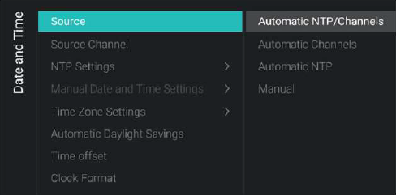
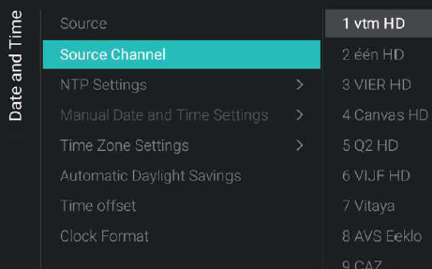
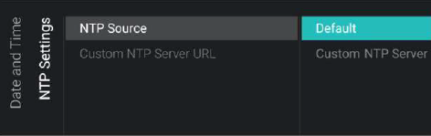
1st TV - Configure –Date and Time
Navigate to [Date and time]
[Source]=Automatic NTP/Channels
[Date and time]->[Source Channel]
Set it to the TV channel that you want to sync time from (and same as your switch on channel)
[Date and time]->[NTP Settings]->[NTP source] = Default

Slide 18
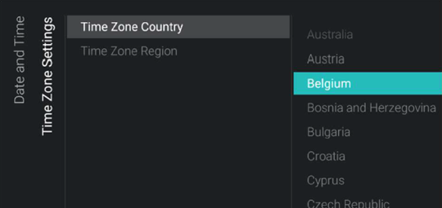
1st TV - Configure – Timezone
Navigate to the [Date and Time]->[Time Zone Setting] menu
[Time Zone Country] -> Choose your country (eg. Australia)
[Time Zone Region] -> Choose the time zone region for your selected country (eg. VIC)
NB: If your desired [Time Zone Country] and [Time Zone Region] setting is not available, use [Date and time]->[Time Offset] menu to manually set the UTC time offset for your region.

Slide 19
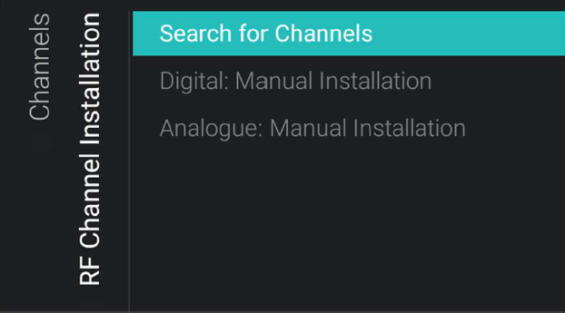
1st TV - Configure – Channel Installation
Navigate to [Channels] -> [RF Channel Installation] -> [Search for Channels]
Choose [Advanced reinstall]
Make country selection
Start the channel search
Enter the Network Frequency and Network ID (Skip if you don’t have Cable TV)
Click Done
TV will tune to the first installed channel

Slide 20
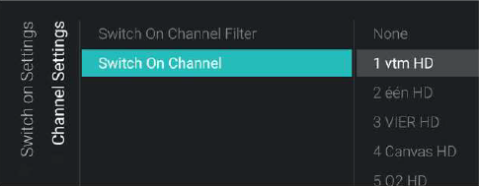
1st TV - Configure – Switch On Channels
Navigate to [Switch On Settings]
[Channel Settings] -> [Switch On Channel]
Set it to the TV channel that you want to start the TV on to every time it is powered on (eg. 7 HD)

Slide 21
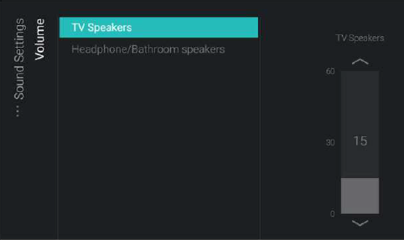
1st TV - Configure – Switch On Volume
Navigate to [Switch on Settings]->[Sound Settings] -> [Volume]
[TV Speakers]: change default volume for TV speakers when turned on
[Headphone/Bathroom speakers]: change default volume for the headphone and bathroom speakers when turned on
Recommended value 15

Slide 22
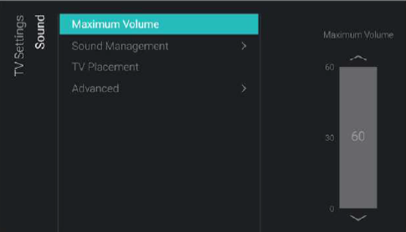
1st TV - Configure – Maximum Volume
Navigate to [TV Settings] [Sound]
Set [Maximum Volume] to the desired value
this will be the maximum volume that a guest can set on the TV
Recommended value: 30

Slide 23
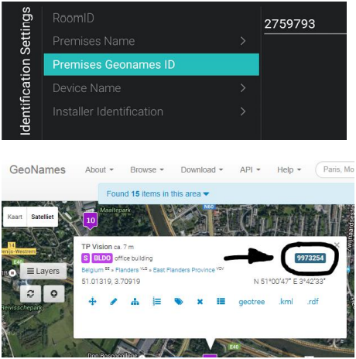
1st TV - Set TV ID Settings - common
Navigate to [Identification Settings]
[RoomID] = Confirm room ID is correct - should have already been set in Basic TV Settings
[Premises Geonames ID]: set the ID for the weather service visible from the dashboard. Find the ID on www.geonames.org, search for your location, open it and check the location ID as marked in the screenshot.
[Premises Name]: name seen at the top of the dashboard.

Slide 24
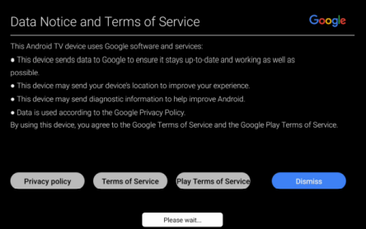
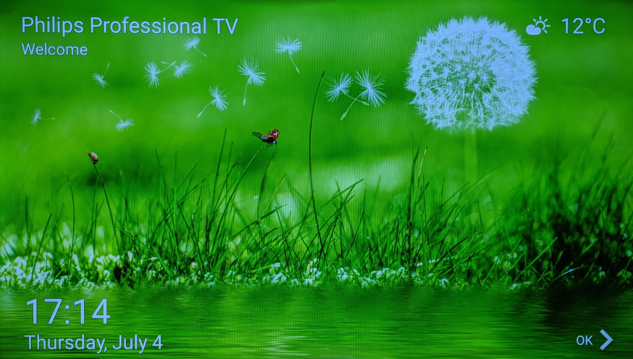
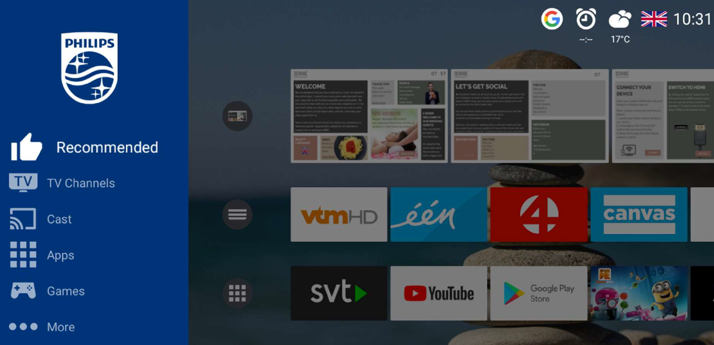
1st TV - Configure – Dashboard (Optional)
The TV will show Google Terms of Service, followed by a Welcome Screen, followed by the default dashboard on startup
If you do NOT want this to be shown:
ToS
[Guest Management]->[Display Guest ToS] = OFF
Welcome screen
[Features]->[Welcome screen]->[ScreenSaver as Welcome Screen] = NO
Dashboard
[Switch On Settings]->[Feature Settings]->[Switch On Feature] = None
(or any other feature you need to show on Switch On)

Slide 25
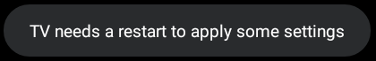
Store TV Settings
Several Professional settings will be applied immediately once you change the settings without a reboot. For some settings a reboot is still required.
If the message does not display, a reboot is not required
Press “Back” until you exit the [Professional settings] menu
If restart is necessary, a notification appears that the TV needs to restart to apply some settings:
Reboot the TV by unplugging from the mains power and plugging the TV again. After the reboot your new settings will be applied.

Slide 26
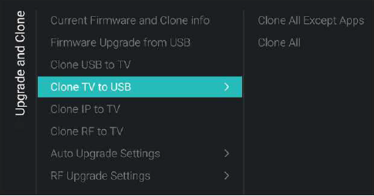
1st TV – Clone out (Create TV Clone File)
It is assumed that at this stage you still have the USB Drive (formatted as FAT32 with allocation = 64kilobytes) with the latest SW in the USB1 on the rear bottom of the TV
Enter Professional Menu
Navigate to [Upgrade and Clone] -> [Clone TV to USB] -> [Clone All]
You will see the following folder in the root of your USB Drive:
For xxHFLx014: TPM181HE_CloneData
This is now your Master Clone file which contains all TV settings.

Slide 27
Other TVs – Duplicate USB with SW & Clone
Prepare other USB Drives
Format other USB Drives with to following parameters
File system = FAT32
Allocation unit size = 64 kilobyte
Copy and paste all files from the USB Drive created in previous slides into these other USB Drives

Slide 28
Other TVs – Set up
Connect Network, Antenna and Power
Take note of USB 1 Location
Yellow RJ45 Interface is not Ethernet port.. It is Serial port
NOT FOR NETWORK CONNECTION
NETWORK
ANTENNA
USB 1

Slide 29
Other TVs – Update SW & Clone In
Plug the USB Drive with the latest SW version and the clone file into the USB1 Port
Turn on TV
Next – TV should automatically detect the SW in the USB

Slide 30

Other TVs – Update SW
TV will automatically detect the USB Drive containing the SW update, download the file to the TV’s memory and begin SW installation
If this doesn’t happen:
Try a different USB Drive model
Confirm USB is formatted and prepared correctly
Confirm USB has both SW and Clone file

Slide 31
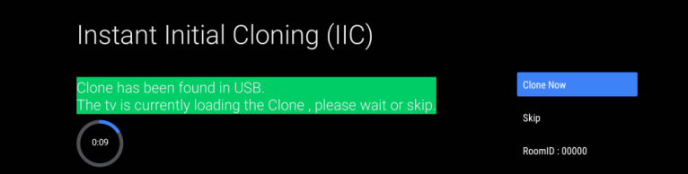
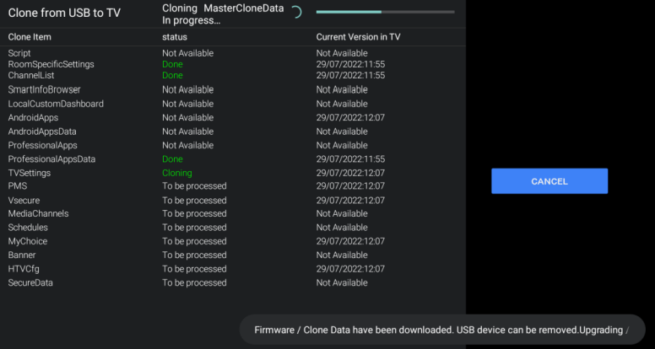
Other TVs – Automatic Clone In
When the update is complete, the TV will reboot itself and detect the clone file on the USB Drive
Cloning In will be initiated immediately and when it finishes, you’ll get “Clone From USB to TV Successful” message.
Click Close to Continue

Slide 32
Other TVs – Customising – Room ID & Static IP
Although most settings are cloned in, there is some configuration that will be unique for each TV, such as Room ID and Static IP Address
Navigate to [Identification Settings]
Set [RoomID]
(If IP Address is done via DHCP, you can ignore the following step)
Navigate to [Wireless and Networks] -> [Connect to Network] menu.
Choose [Wired] from selection
Set Static IP Address

Slide 33
Post Install - Channel Re-Installation
Navigate to [Channels] -> [RF Channel Installation] -> [Search for Channels]
Choose option depending on what you need:
[Update Digital Channels] to update exisiting digital channels
[Quick reinstall] to scan and replace your channels using default settings
[Advanced reinstall] to scan and replace your channels via the full wizard

Slide 34
Post Install – Clone out (Create TV Clone File)
After making changes in the professional menu, a new TV master clone file will need to be created to capture any new settings changes for future use. Here is the procedure.
Prepare the USB Drive (formatted as FAT32 with allocation = 64kilobytes)
Insert the USB Drive to USB1 on the TV
Navigate to [Upgrade and Clone] -> [Clone TV to USB] -> [Clone All]
You will see the following folder in the root of your USB Drive:
For xxHFLx014: TPM181HE_CloneData
This is now your Master Clone file which contains all updated TV settings.

Slide 35
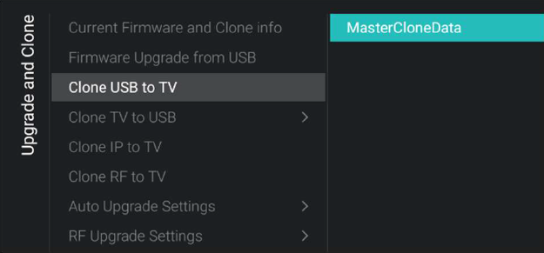
Post Install – Clone in to TV
To apply a new clone file to a TV, do the following:
Connect a USB Drive with a clone file to USB1 on the TV.
Navigate to [Professional Settings] -> [Upgrade and Clone] -> [Clone USB to TV] -> [MasterCloneData]
Wait until process finished.
Note:
TV will retain Room ID and Static IP address

Slide 36
Post Install – Reinstall TV
Sometimes, you may want to reset and reinstall the TV from scratch:
Navigate to [Professional Settings] -> [Reset] -> [Reinstall TV] -> [Yes]
Press the “OK” button to reinstall the TV.
You will see an “erasing…” message (this can take several minutes)
TV will reboot itself
You will then see first screen of the virgin installation. (IIC Screen)

Slide 37
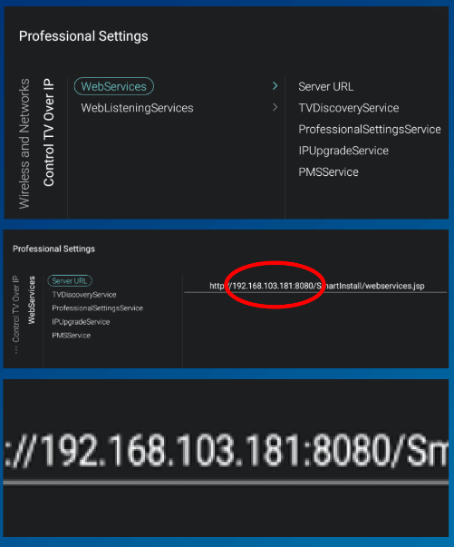
Other tasks – Connect to CMND over IP
For easy TV detection in CMND
Navigate to [Wireless and Networks] [Control TV Over IP]
Ensure all Webservices and WebListeningServices are enabled
Set [Server URL] to:
http://CMNDIPaddress:8080/webservices.jsp

Slide 38
Q&A
Questions?

